Slide 1
Software Testing
UNIT 5

Slide 2
What is software testing ?
Software testing is a way to assess the quality of the software and to reduce the risk of software failure in operation.
It involves testing of all components under the required services to confirm that whether it is satisfying the specified requirements or not.
What is quality assurance ?
Quality Assurance is the set of activities that defines the procedures and standards to develop the product.
Quality Assurance is a systematic way of creating an environment to ensure that the software product being developed meets the quality requirements.
Notes:
[1] - ISTQB Syllabus
[2] - Javatpoint.com
[3] -

Slide 3
Verification & Validation
Sr.No | Verification | Validation
1 | Verification addresses the concern: "Are you building it right?" | Validation addresses the concern: "Are you building the right thing?"
2 | Ensures that the software system meets all the functionality. | Ensures that the functionalities meet the intended behavior.
3 | Verification takes place first and includes the checking for documentation, code, etc. | Validation occurs after verification and mainly involves the checking of the overall product.
4 | Done by Developers. | Done by Testers.
5 | It has static activities, as it includes collecting reviews, walkthroughs, and inspections to verify a software. | It has dynamic activities, as it includes executing the software against the requirements.
6 | It is an objective process, and no subjective decision should be needed to verify a software. | It is a subjective process and involves subjective decisions on how well a software works.

Slide 4
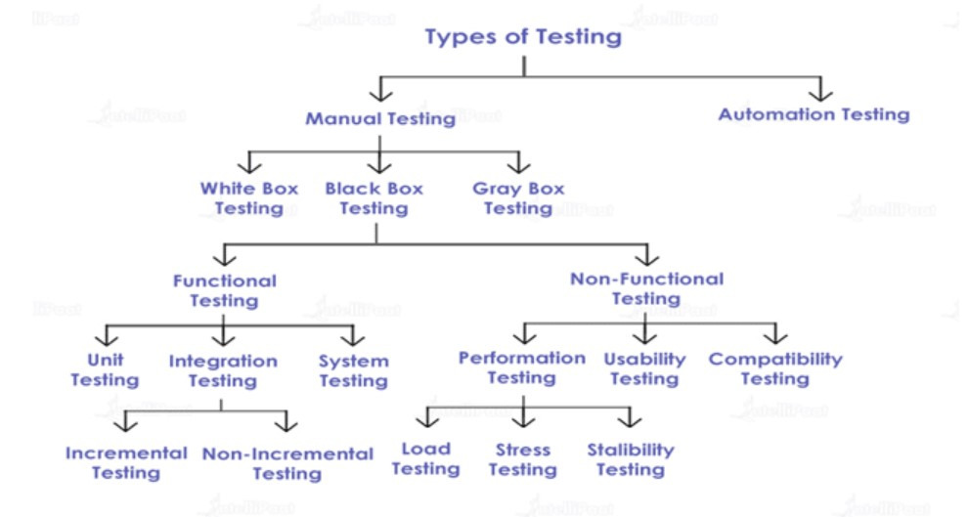
^{[3]}
Notes:
[1] - ISTQB Syllabus
[2] - Javatpoint.com
[3] - https://intellipaat.com/blog/types-of-software-testing/

Slide 5
White-box testing
White-box testing is also known as structural testing, glass-box testing, transparent-box testing, or clear-box testing. This kind of testing is executed at the unit level and is based on the internal code structure.
The test cases are designed based on the internal perspective of the system and programming skills such as code statements, conditions, branches, paths, etc.
Black-box testing
Black-box testing is also known as behavioral testing, specification-based testing, or input-output testing.
It is a testing method where testers, without looking at the internal code structure, test the functionality of the software.
Black-box testing is again divided into two different types of testing: Functional Testing and Non-Functional Testing.
Notes:
[1] - ISTQB Syllabus
[2] - Javatpoint.com
[3] -

Slide 6
Statement coverage Read A Read B if A > B Print “A is greater than B” else Print “B is greater than A” endif
CASE 1:-
CASE 2:-
If A = 7, B= 3
No of statements Executed= 5
Total statements= 7
Statement coverage= 5 / 7 * 100 = 71.00 %
If A = 4, B= 8
No of statements Executed= 6
Total statements= 7
Statement coverage= 6 / 7 * 100 = 85.20 %

Slide 7
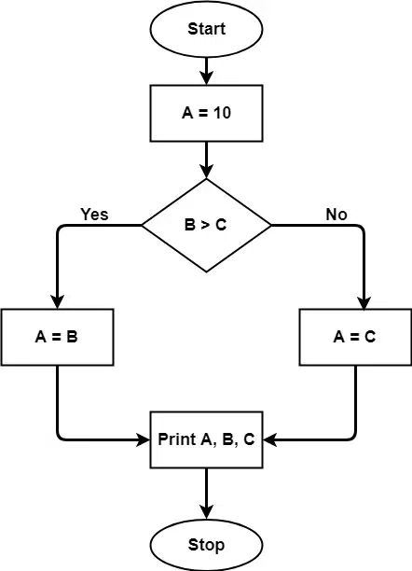
Cyclomatic Complexity
A = 10 IF B > C THEN A = B ELSE A = C ENDIF Print A Print B Print C

Slide 8
Formula for CC
Cyclomatic Complexity = Edges – Nodes +2 = E-N+ 2 = 7-7+2 = 2
Cyclomatic Complexity may be defined as-
It is a software metric that measures the logical complexity of the program code.
Cyclomatic Complexity | Meaning
1 – 10 | Structured and Well Written Code High Testability Less Cost and Effort
10 – 20 | Complex Code Medium Testability Medium Cost and Effort
20 – 40 | Very Complex Code Low Testability High Cost and Effort
> 40 | Highly Complex Code Not at all Testable Very High Cost and Effort

Slide 9
What are Black Box testing techniques?
There are various test case design techniques applied for black-box testing:
Boundary Value Analysis
Equivalence partitioning
State Transition Testing
Decision Table Testing
Graph-Based Testing
Error Guessing Technique

Slide 10
Equivalence partitioning
This test case designing techniques checks the input and output by dividing the input into equivalent classes. The data must be tested at least once to ensure maximum test coverage of data. It is the exhaustive form of testing, which also reduces the redundancy of inputs.
For example: For a Textbox which requires “Enter Quantity” ______to be tested till 100.
Valid class: 1 to 100 (any number), Invalid class: -1 (checking the lowest of lowest), Invalid class: 101(highest of highest).
Test Case Id | Equivalence Class | Input | Expected Output | Actual Output | Result
TC 01 | Valid Class ( 1 to 100) | 25 | Accepted | Accepted | Pass
TC 02 | Invalid Class (less than 1) | -4 | Error | Error | Pass
TC 03 | Invalid Class (more than 100) | 105 | Error | Error | Pass

Slide 11
Boundary Value Analysis
It is the widely used black-box testing, which is also the basis for equivalence testing. Boundary value analysis tests the software with test cases with extreme values of test data. BVA is used to identify the flaws or errors that arise due to the limits of input data
Test Case Id | Equivalence Class | Input | Expected Output | Actual Output | Result
TC 01 | m | 1 | Accepted | Accepted | Pass
TC 02 | n | 100 | Accepted | Accepted | Pass
TC 03 | m - 1 | 0 | Error | Error | Pass
TC 04 | n +1 | 101 | Error | Error | Pass
TC 05 | random value | 55 | Accepted | Accepted | Pass
TC 06 | m+ 1 | 2 | Accepted | Accepted | Pass
TC 07 | n -1 | 99 | Accepted | Accepted | Pass

Slide 12
Functional testing
Functional testing focuses only on the output to verify the functionality of the software and how it fares against the specified requirements.^{[3]}
Further divided into three types : ^{[3]}
Unit Testing : Unit testing involves a developer separately testing each and every unit of an application. Each source code module is tested in the developer’s environment.
Integration Testing : Integration testing, involves the testing of the connectivity or transfer of data between unit-tested modules. This type of testing includes the top-down approach, the bottom-up approach, and the sandwich approach.
Incremental Testing : Incremental integration testing is a form of testing in which a module is tested before being merged with another module. The integration is then tested before adding another module or component.
Non-Incremental Testing : Non-incremental integration, in which all components are merged ahead of time and the complete programme is tested, is sometimes attempted.
System Testing : Testing the system in a certain environment. Eg-> testing the system on different hardware, O.S, specific software.
Notes:
[1] - ISTQB Syllabus
[2] - Javatpoint.com
[3] -

Slide 13
Non-functional testing
Every organization has a separate team for this kind of testing called the non-functional testing (NFT) team or the performance team.
Here, the testing is done for non-functional parameters such as stress testing, load testing, recovery testing, volume, security, accountability, etc.^{[3]}
Further divided into three types : ^{[3]}
Performance Testing : Performance testing examines the functionality of software components. These tests uncover flaws in software architecture and design.
Load Testing : Load testing generally refers to the practice of modeling the expected usage of a software program by simulating multiple users accessing the program concurrently.
Stress Testing : Stress testing is the process of determining the ability of a computer, network, program or device to maintain a certain level of effectiveness under unfavorable conditions.
Stability Testing : Stability Testing is a type of non-functional software testing performed to measure efficiency and ability of a software application to continuously function over a long period of time.
Usability Testing : Non-functional testing includes usability testing as one of the testing methods. Usability testing is all about ensuring that the software is simple to use for the consumers.
Compatibility Testing : Customer satisfaction is ensured by compatibility testing, which is also non-functional testing. Its purpose is to see if your software program or product can run in a variety of browsers, databases, hardware, operating systems, mobile devices, and networks.
Notes:
[1] - ISTQB Syllabus
[2] - Javatpoint.com
[3] -

Slide 14
Agile Testing
Agile Testing is a testing practice that follows the rules and principles of agile software development. Unlike the Waterfall method, Agile Testing can begin at the start of the project with continuous integration between development and testing. Agile Testing methodology is not sequential (in the sense it’s executed only after coding phase) but continuous.
Agile Testing Methods –
There are various agile testing methods as follows:
• Behavior Driven Development (BDD)
• Acceptance Test Driven Development (ATDD)
• Exploratory Testing

Slide 15
Behavior Driven Development (BDD)
Improves communication amongst project stakeholders so that all members correctly understand each feature before the development process starts. There is continuous example-based communication between developers, testers, and business analysts. The examples are called Scenarios which are written in a special format called Gherkin Given/When/Then syntax. The scenarios hold information on how a given feature should behave in different situations with different input parameters. These are called “Executable Specifications” as it comprises of both specification and inputs to the automated tests.

Slide 16
Acceptance Test Driven Development (ATDD)
ATDD focuses on involving team members with different perspectives such as the customer, developer, and tester. Three Amigos meetings are held to formulate acceptance tests incorporating perspectives of the customer, development, and testing. The customer is focused on the problem that is to be solved, the development is focused on how the problem will be solved whereas the testing is focused on what could go wrong. The acceptance tests are a representation of the user’s point of view and it describes how the system will function. It also helps to verify that the system functions as it is supposed to. In some instances acceptance tests are automated.
“As I want to be So I can purchase them a able to add Discuss: Coming Up With Acceptance Criteria buyer items to my shopping cart “
If I add another instance of the same product to the cart, should it increase the number or add it as a new item?
Is there a limit to how many units of the same product I can add to my shopping cart?
Is there a limit to how many items I can add to my cart?

Slide 17
Exploratory Testing
In this type of testing, the test design and test execution phase go hand in hand. Exploratory testing emphasizes working software over comprehensive documentation. The individuals and interactions are more important than the process and tools. Customer collaboration holds greater value than contract negotiation. Exploratory testing is more adaptable to changes. In this testers identify the functionality of an application by exploring the application. The testers try to learn the application, and design & execute the test plans according to their findings.

Slide 18
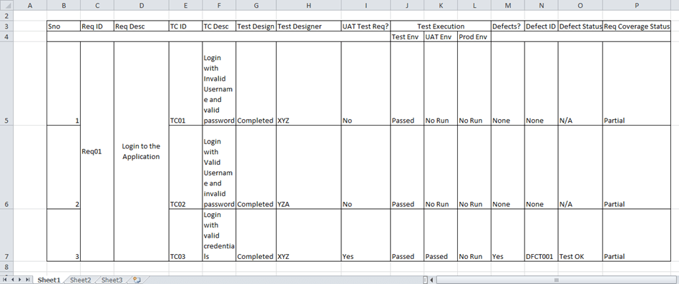
Validation /Requirement Validation

Slide 19
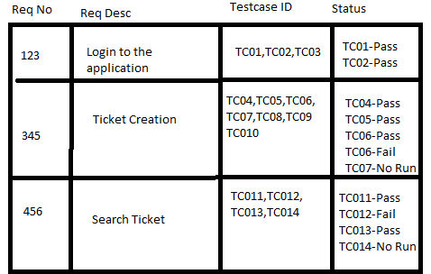
REQUIREMENT REALTED MAINTENACE METRICS
Requirement Traceability Matrix (RTM) is a document that maps and traces user requirement with test cases. It captures all requirements proposed by the client and requirement traceability in a single document, delivered at the conclusion of the Software development life cycle. The main purpose of Requirement Traceability Matrix is to validate that all requirements are checked via test cases such that no functionality is unchecked during Software testing.

Slide 20
THANK YOU

